Slide 1
Intermediate Structure Auxiliary Verbs
Special Semester 2015-2016
© Yosa A. Alzuhdy, M.Hum.
 0815 7887 1437 |  0811 2545 567
 yosa@uny.ac.id
English Language and Literature Study Program
English Department
State University of Yogyakarta

Slide 2
What is an auxiliary verb?
An auxiliary verb is also called a helper verb
It comes before some verbs
Not all sentences have an auxiliary
Main Auxiliary Verbs : be, have, do
Modal Auxiliary Verbs : can, could, shall, should, will, would, may, might, must
Similar to modals : ought to, have to, need to, be supposed to, be about to, etc…

Slide 3
Sentences with no auxiliary verb
I played football last night
I walk this way to school every day
I like chocolate
Can you identify the verbs in these sentences?

Slide 4
Sentences with missing auxiliary verbs
Can you suggest the necessary auxiliary verbs?
I _____ walking along the dusty road yesterday.
Tomorrow I _____ swim for my school.
I _____ very good at maths.
Dad _____ the dishes because mum cooks the tea.
I _____ spell all of the words on my list.
The little girl _____ very happy now.
There _______ some students absent last week.
Each of the participants ________ given the same task.
Some of the news _____ just unbelievable.
All of the yard ______ covered with the leaves.

Slide 5
To be
am, is, are, was, were
Is followed by the present or past participle in the sentence
e.g. I am going to the park. (going = present)
Kylie is singing at Wembley stadium.
Fish is usually eaten with chips. (eaten = past participle)
He was beaten by a better player.
They were happy when they saw their mother.
She was in Bali when I visited her house.
We are the champions in this competition.
Try to put each of these auxiliaries into a sentence of your own.

Slide 6
To have
have, has, had
These are followed by the past participle of the next verb
e.g.
I have eaten all of my food.
John has climbed Mount Kerinci.
Debbie had hidden all of Paul’s pencils.
Try to put each of these auxiliaries into a sentence of your own.

Slide 7
To do
do, does, did
These are followed by the base form of a verb
e.g. I do work very hard.
Johnny does try his best.
They did win the game last week.
Does she enjoy the ice cream?
Do you agree with my idea?
Try to put each of these auxiliaries into a sentence of your own.

Slide 8
Modals
can, will, shall, could, would, should, may, might, must
These are followed by the base form of a verb
e.g. They can finish the exercise in time.
She will never come to the place again.
The boy might have stolen the bicycle.
Use each of these in a sentence of your own:
can walk; will try; shall play; could tidy; would drive; should work; may eat; might choose; must breathe
Functions of modals → see explanation in the module!

Slide 9
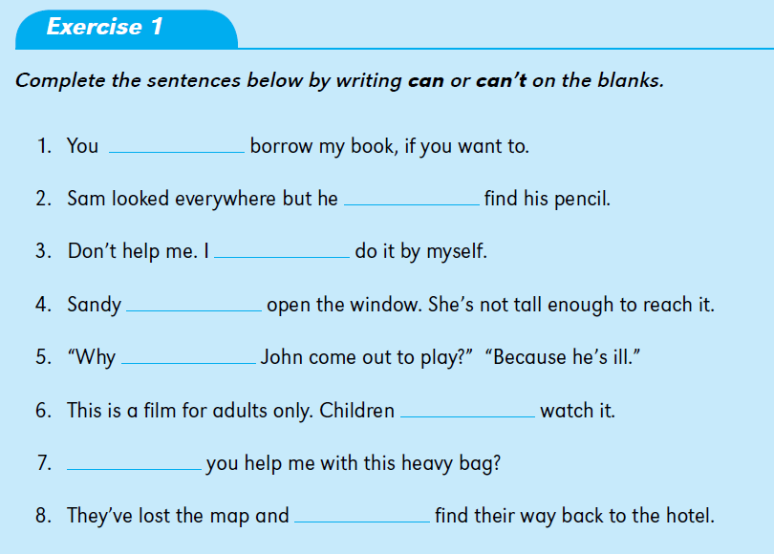
can
can’t
can
can’t
can’t
can
Can
can’t

Slide 10
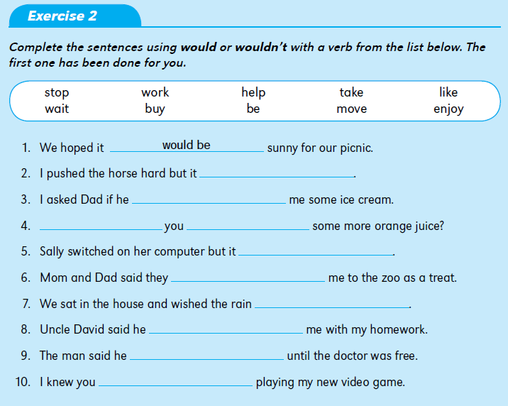
wouldn’t move
would buy
Would
like
wouldn’t work
would take
would stop
would help
would wait
would enjoy

Slide 11
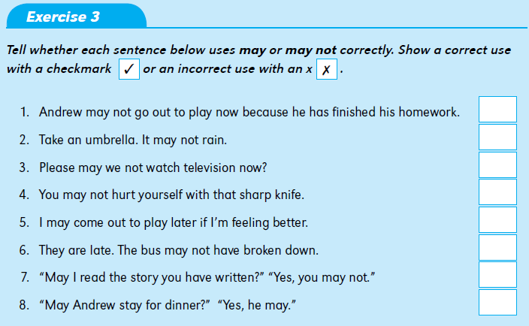
✗
✗
✗
✗
✓
✗
✗
✓

Slide 12
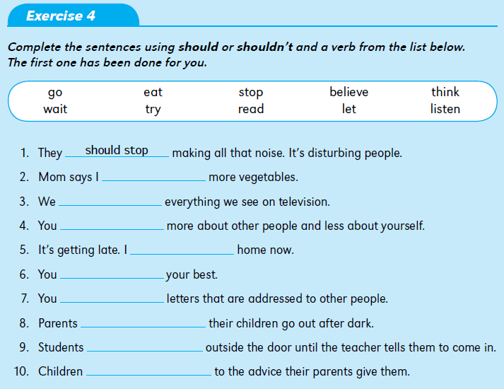
should eat
shouldn’t believe
should think
should go
should try
shouldn’t read
shouldn‘t let
should wait
should listen

Slide 13
ought to
ought to eat
oughtn’t to believe
ought to think
ought to go
ought to try
oughtn’t to read
oughtn‘t to let
ought to wait
ought to listen

Slide 14
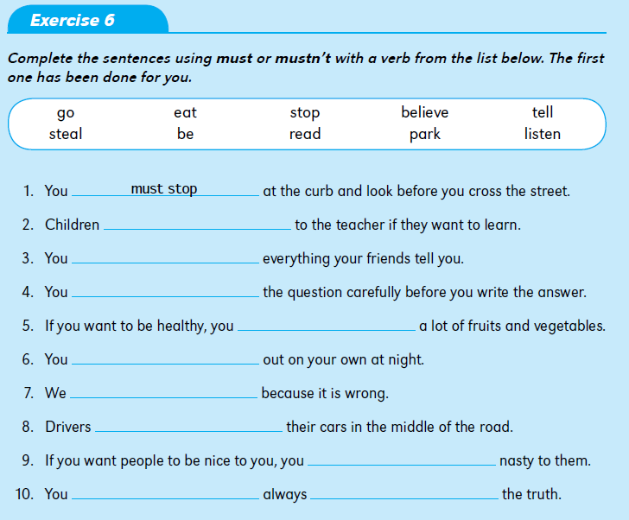
must believe
must listen
must read
must eat
mustn‘t go
mustn‘t steal
mustn‘t park
mustn‘t be
must
tell

Slide 15
Now, do the exercises on BeSmart about Auxiliary Verbs

Slide 16
PERFECT PRACTICE
makes
PERFECT RESULT

